Slide 1
AADT Dashboard
Aditya Marathe
Arizona State University
Acknowledgement
Dr. Xuesong Zhou
Dr. Baloka Belezamo

Slide 2
Brief Introduction
The AADT dashboard, previously AADT forecaster, can display the forecasted AADT data for the selected route, milepost range and projection years
Reason
Engineers require AADT data for their desired route, BMP, EMP and projection years
Requests are tedious to fulfill as they require manual calculations
Solution was to create an automated platform to fulfill such requests
First idea was to use Excel Spreadsheet
Unsynchronized data
Dependent on excel version
Second idea was to use a shared Google Sheets
Cumbersome
Shared use
Pseudo automation
Final idea was to use Python to design an online-accessible Dashboard

Slide 3

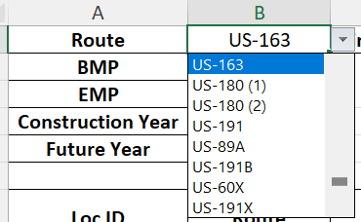
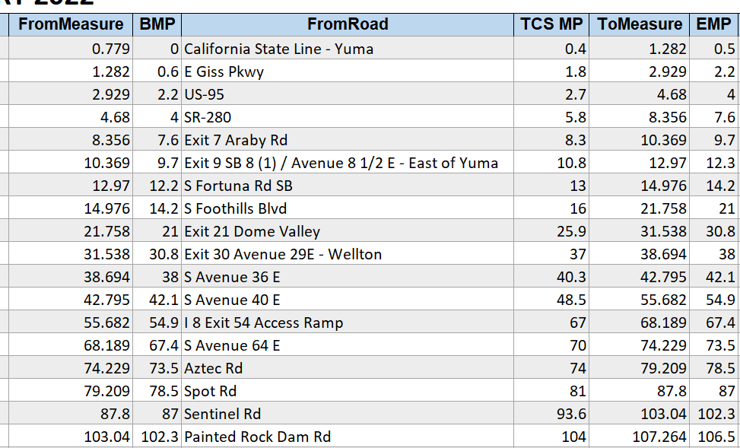
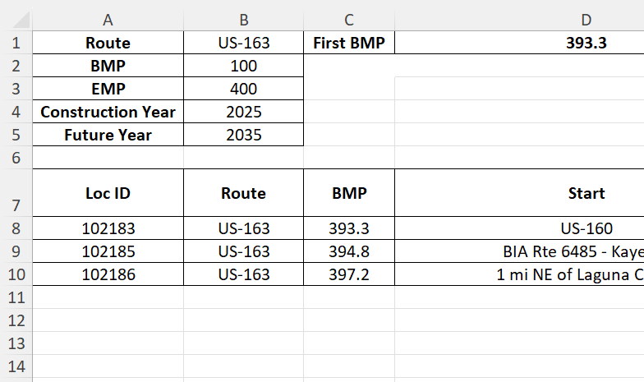
Excel spreadsheet
Features
Automated forecasting
Data filtering
Issues
Cumbersome
Unsynchronized
Harder to update
Limited accessibility
Version history
Ability to forecast AADT based on user input years
Ability to filter the data based on route, BMP and EMP
Display the required data only, filtering out unnecessary data
Display first BMP and last EMP for selected route
Colors for better visual clarity

Slide 4
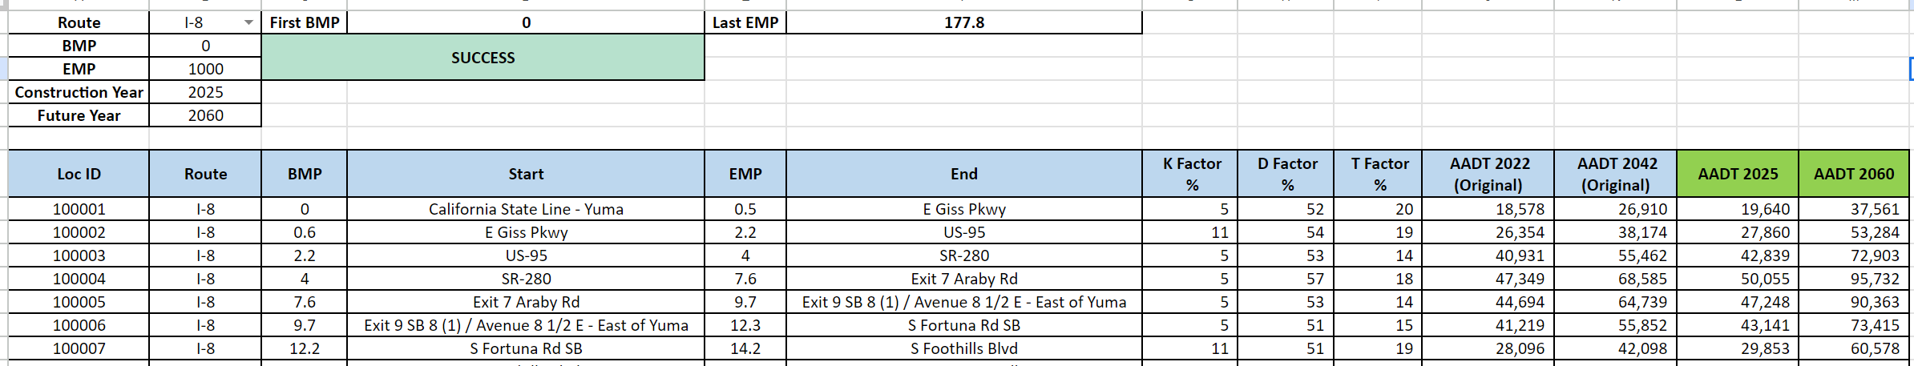
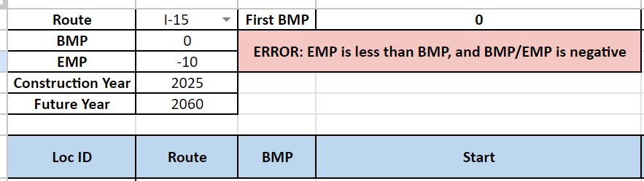
Google Sheets
Features
Automated forecasting
Data filtering
Synchronized
Centralized data
Issues
Cumbersome
Harder to update
Shared use
Version history
Version transfer from excel version
Better visual features
BMP - EMP flexibility
Optimized calculations

Slide 5
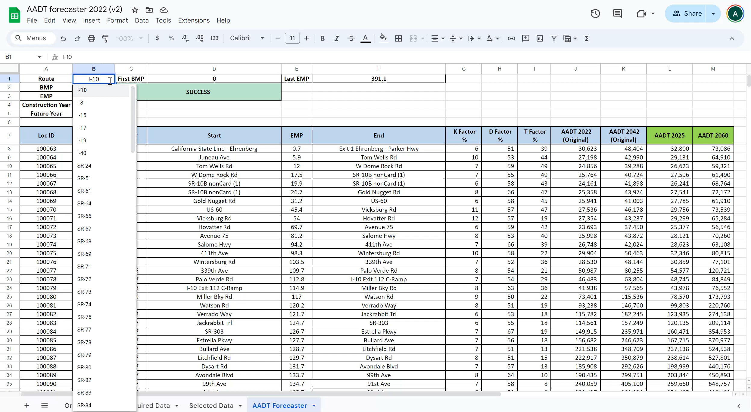
Google Sheets Demonstration

Slide 6
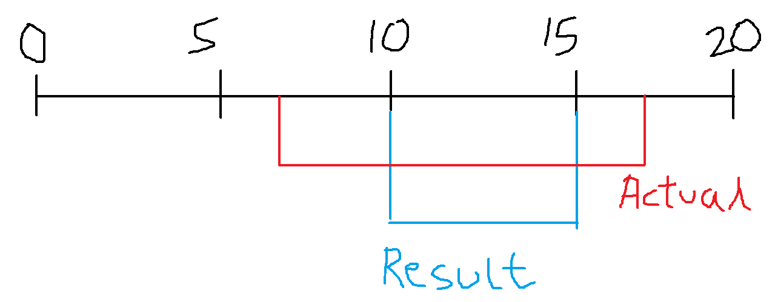
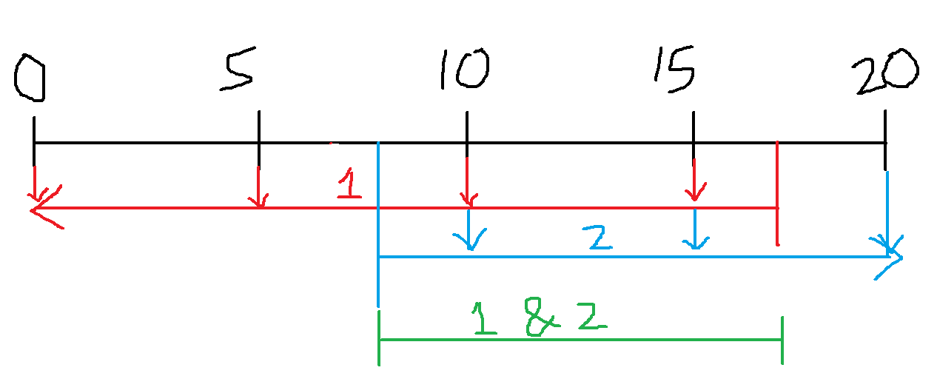
BMP – EMP flexibility logic
Problem: Filtered data was too rigid, which lead to erroneous data display
Example: Assume route segments with mile posts 0, 5, 10, 15 and 20
If the input was, inBMP = 7.5, inEMP = 17.5, then the result should include all route segments between
BMP-5 & EMP-10
BMP-10 & EMP-15
BMP-15 & EMP-20
However, only the route segment BMP-10 & EMP-15 was displayed, which is not correct
Logic Fix
(BMP < inEMP)
(EMP > inBMP)
Old Logic
New Logic

Slide 7
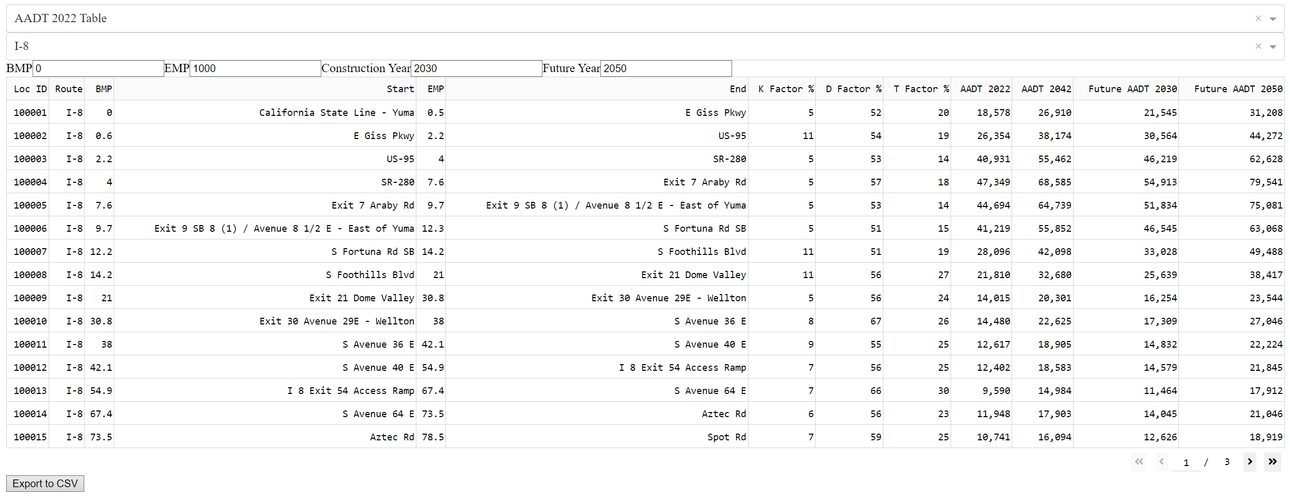
Dashboard
Features
Automated forecasting
Data filtering
Synchronized
Centralized data
Easy to update
Potential
Faster calculations
Visualization options
Easy accessibility
Customization
Version history
Display AADT table similar to other versions
Dropdown, inputs and limiters
Download function
Automated dataframe and header generation
Data cleaning and validation
File selector

Slide 8

Dashboard Demonstration

Slide 9
THANK YOU

